Slide 1
Create a presentation in PowerPoint
Xiaoli zhang

Slide 2

What is PowerPoint?
Notes:
https://youtu.be/aOeOn2OK5zY

Slide 3
Overview
Create presentations from a template.
Add text, images, art, chart and videos.
Select a professional design with PowerPoint Designer.
Add transitions and animations.
Save to OneDrive
Share and work with others.
Notes:
Using Example Template to do:
Create presentations from a template.
Add text, images, art, and videos.
Select a professional design with PowerPoint Designer.
Add transitions, animations, and motion.
Save to OneDrive, to get to your presentations from your computer, tablet, or phone.
Share and work with others, wherever they are.

Slide 4
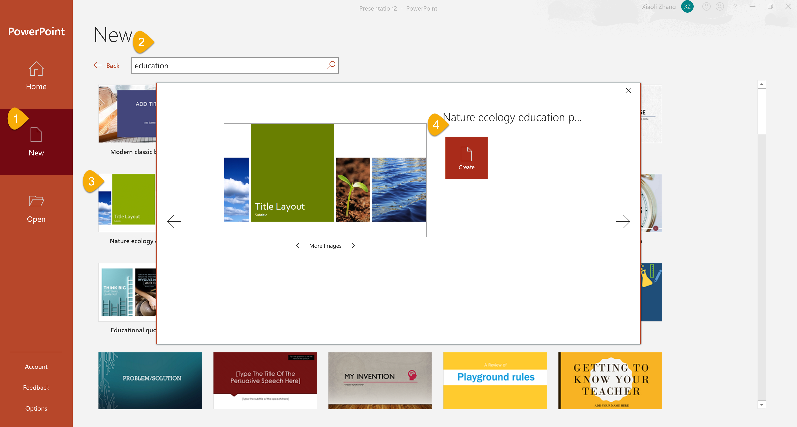
Create presentations from a template
Open PowerPoint → New → Search online template → Select template → Create
Notes:
Apply a template to a new presentation
When you want your PowerPoint presentation to contain carefully arranged elements without having to do excessive manual work, apply a template (.potx file). This gives you a jump-start on a new, blank presentation.

Slide 5
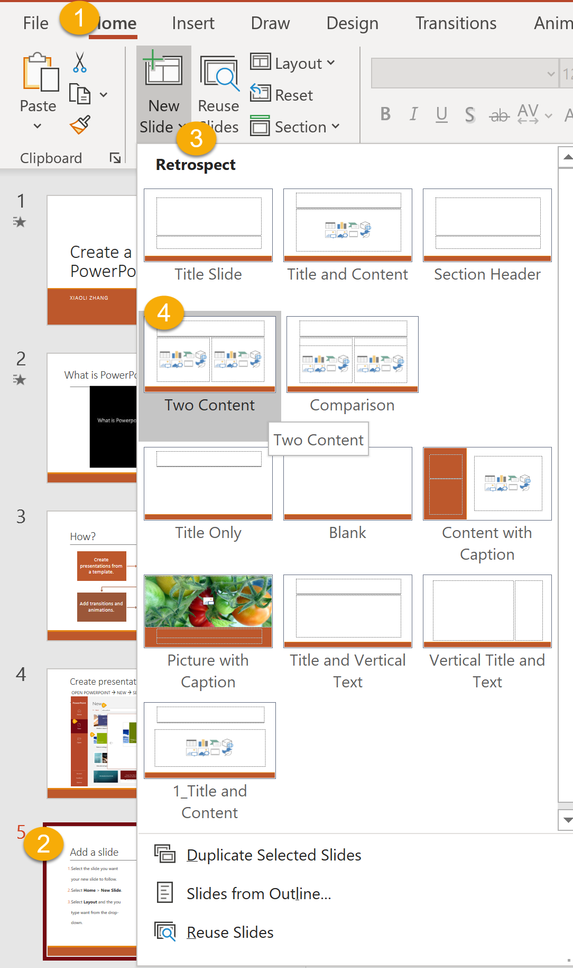
Add a slide
Select the slide you want your new slide to follow.
Select Home > New Slide.
Select Layout and the you type want from the drop-down.
Notes:
Three way to add Slides:
New Slide.
Duplicate Slides.(Using template example slides)
Reuse Slides.

Slide 6
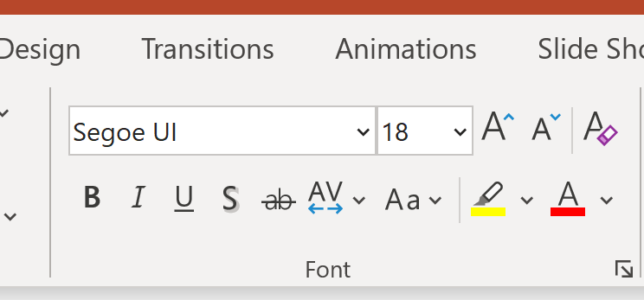
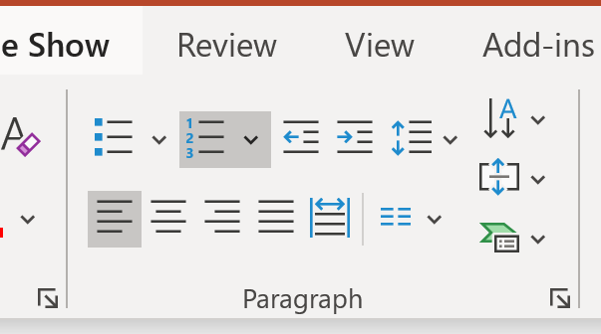
Add and format text
Place the cursor where you want, and type.
Select the text, and then select an option on the Home tab: Font, Font size, Bold, Italic, Underline, ...
To create bulleted or numbered lists, select the text, and then select Bullets or Numbering.
Notes:
Example:
New Slide.(Title and Content Layout with Bullets List)
Duplicate Slides.(Using template example slides: Title and Content Layout with Numbering List)
Reuse Slides.(Title and Content Layout with no List)

Slide 7
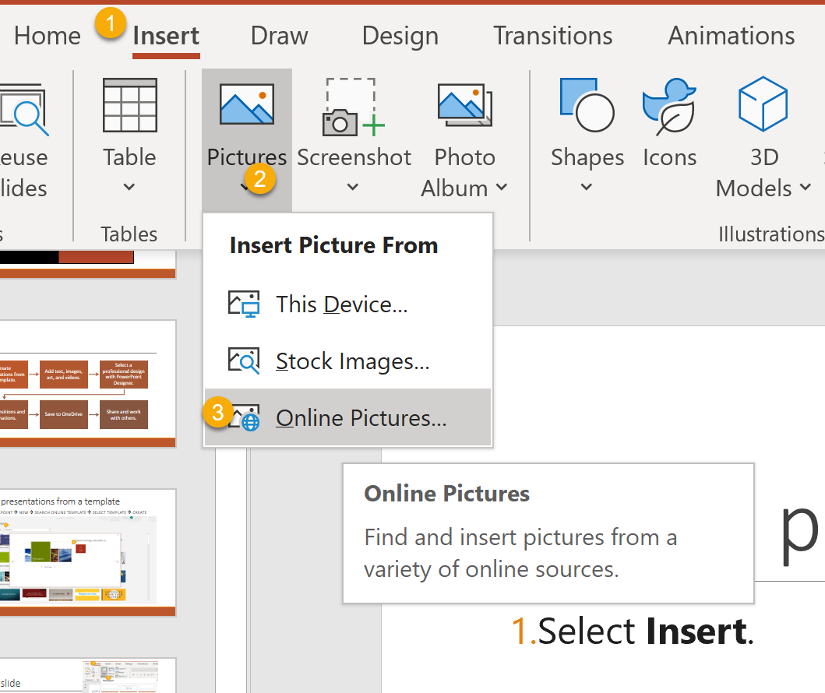
Add a picture, shape, or chart
Select Insert.
To add a picture:
Select Picture.
Browse for the picture you want and select Insert.
To add a shape, art, or chart:
Select Shapes, Icons, SmartArt, or Chart.
Select the one you want.
Notes:
Insert Online Picture.

Slide 8
Add a picture, shape, or chart
Select Insert.
To add a picture:
Select Picture.
Browse for the picture you want and select Insert.
To add a shape, art, or chart:
Select Shapes, Icons, SmartArt, or Chart.
Select the one you want.
Notes:
Insert Online Picture.
Duplicate template Two Content Layout
Insert Online Picture
Using PowerPoint Designer to change Layout

Slide 9
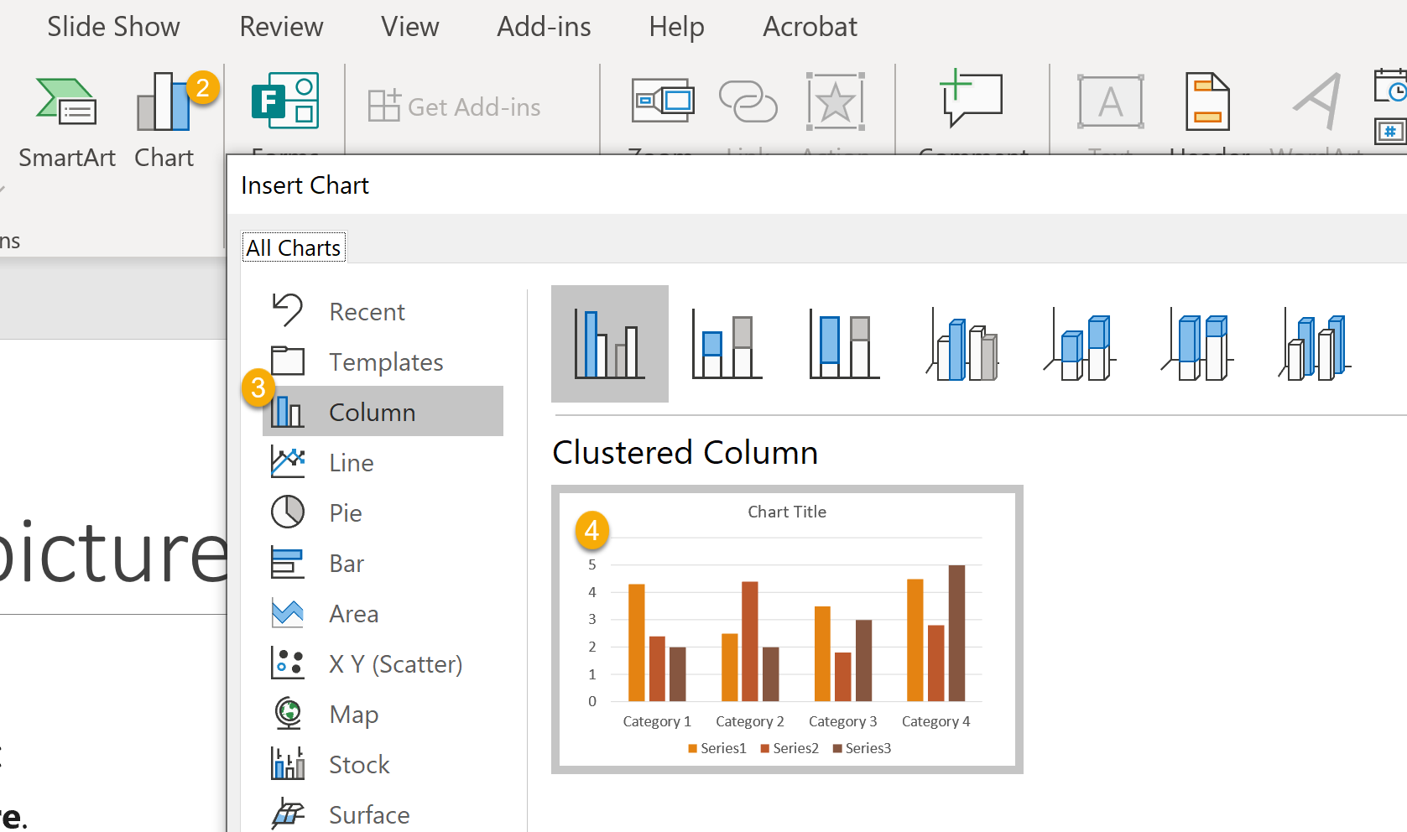
Add a picture, shape, or chart
Select Insert.
To add a picture:
Select Picture.
Browse for the picture you want and select Insert.
To add a shape, art, or chart:
Select Shapes, Icons, SmartArt, or Chart.
Select the one you want.
Notes:
Using Template Chart.

Slide 10
Add a picture, shape, or chart
Select Insert.
To add a picture:
Select Picture.
Browse for the picture you want and select Insert.
To add a shape, art, or chart:
Select Shapes, Icons, SmartArt, or Chart.
Select the one you want.
One
Two
Three
Notes:
Insert SmartArt

Slide 11

Add a picture, shape, or chart
Select Insert.
To add a picture:
Select Picture.
Browse for the picture you want and select Insert.
To add a shape, art, or chart:
Select Shapes, Icons, SmartArt, or Chart.
Select the one you want.
Notes:
Insert Icons

Slide 12
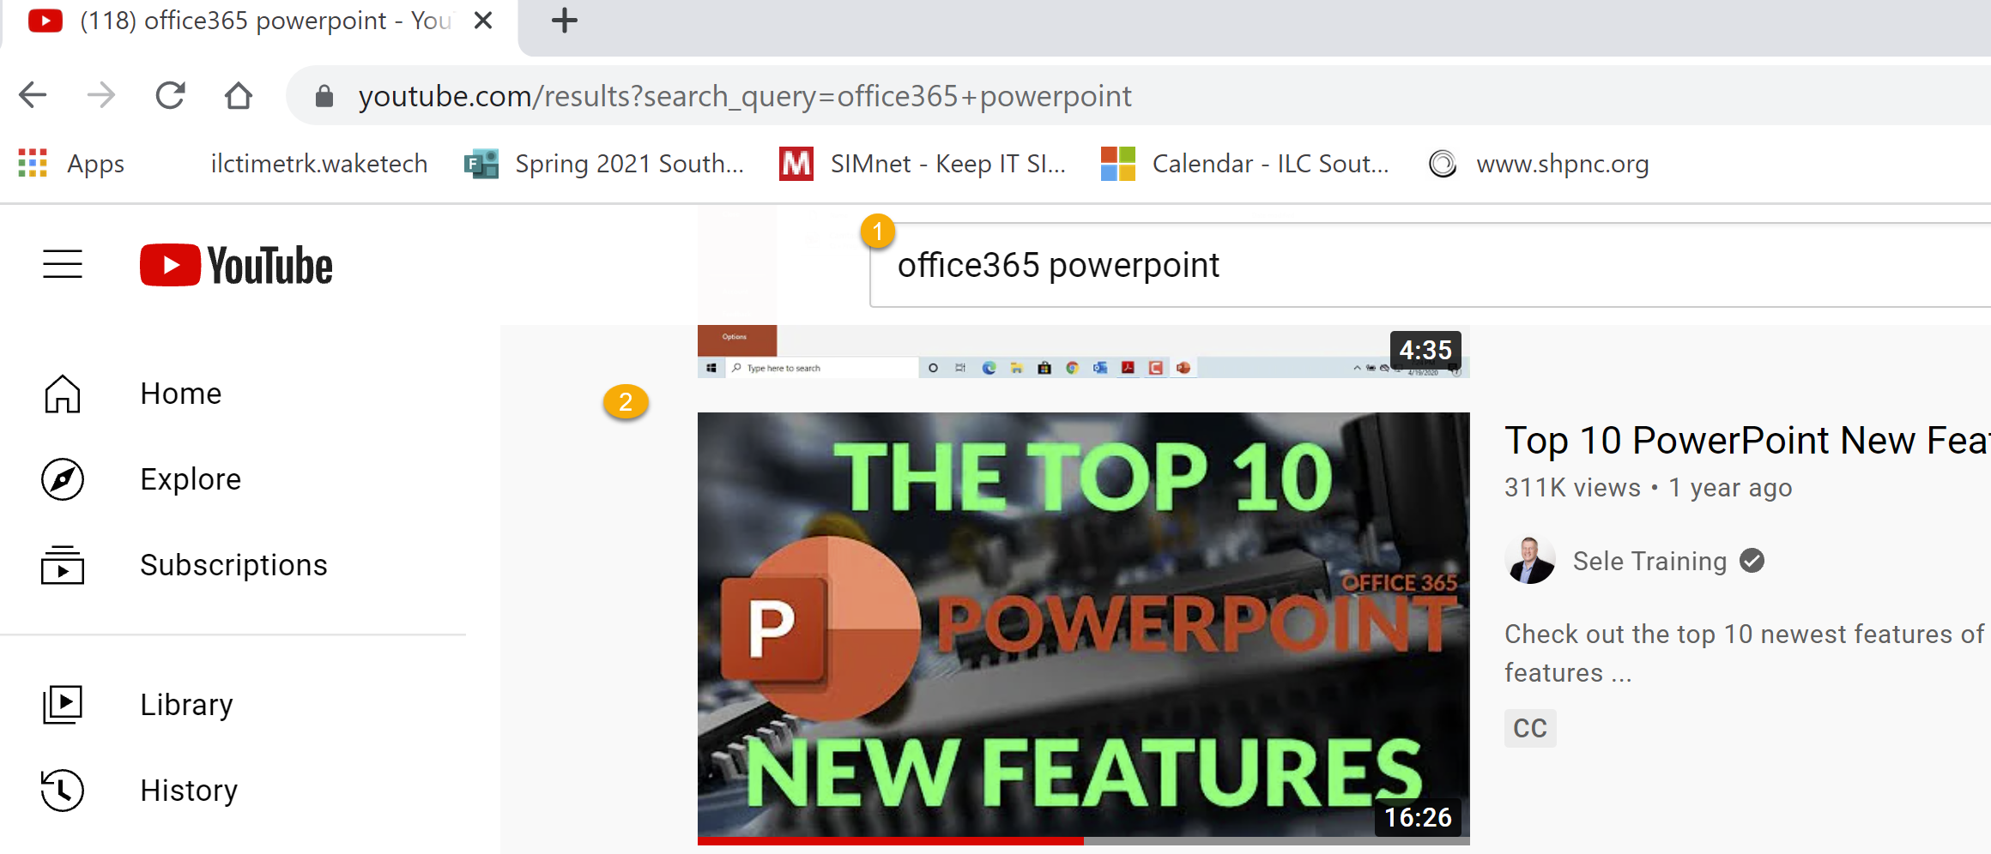
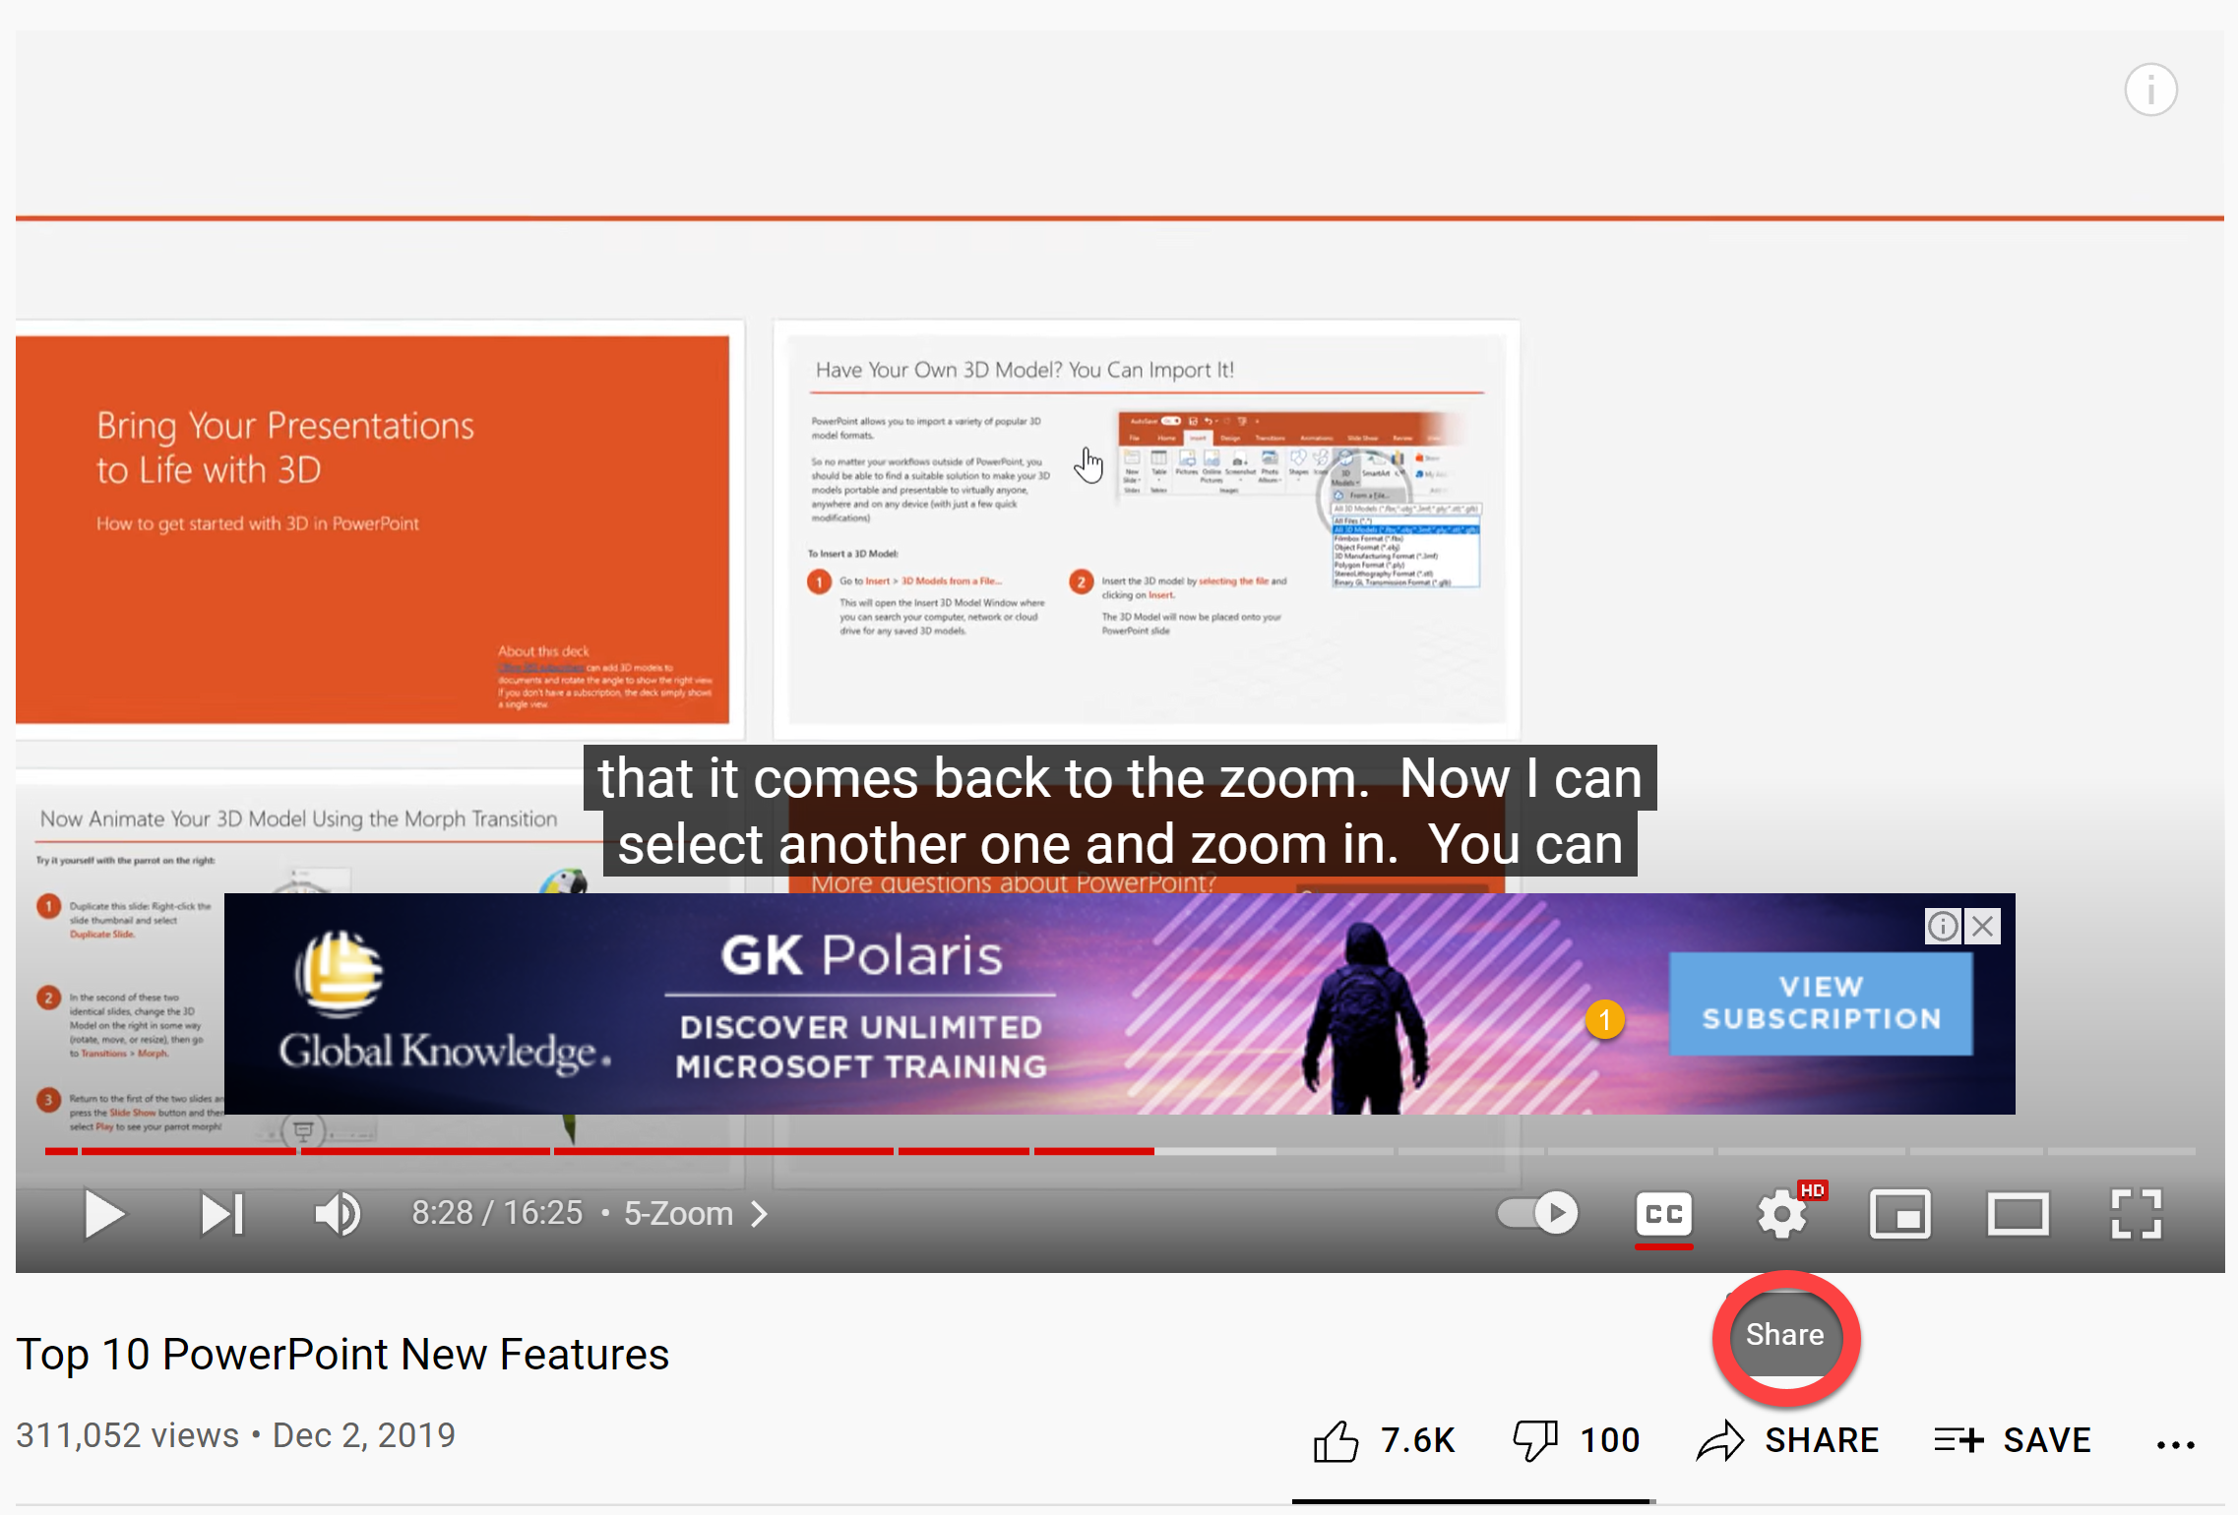
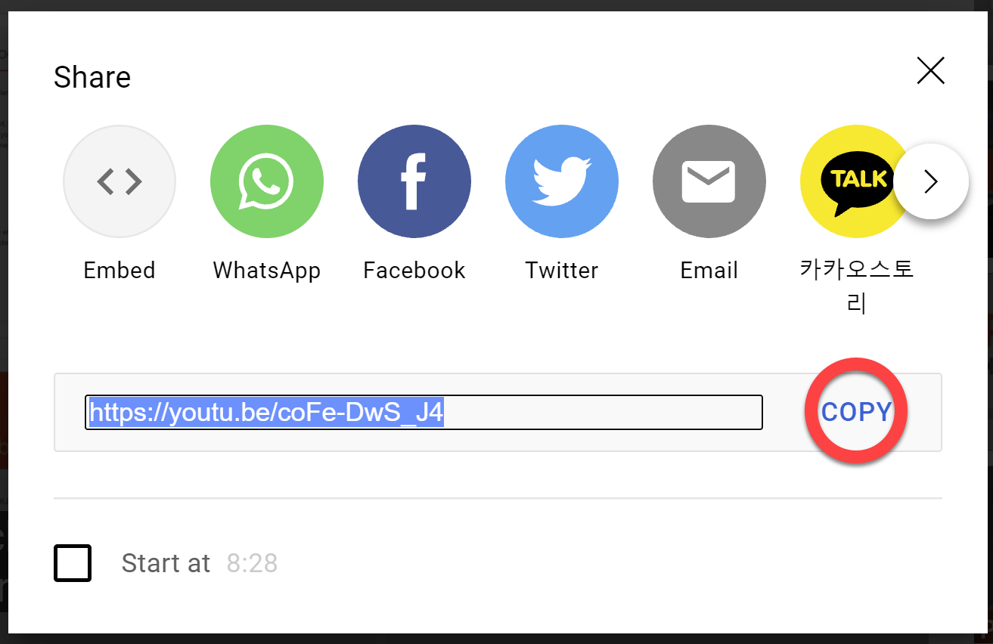
Get the Online Video URL
Select Online Video
Click on Share
Copy the Link
Notes:
https://www.youtube.com/watch?v=coFe-DwS_J4&t=508s

Slide 13
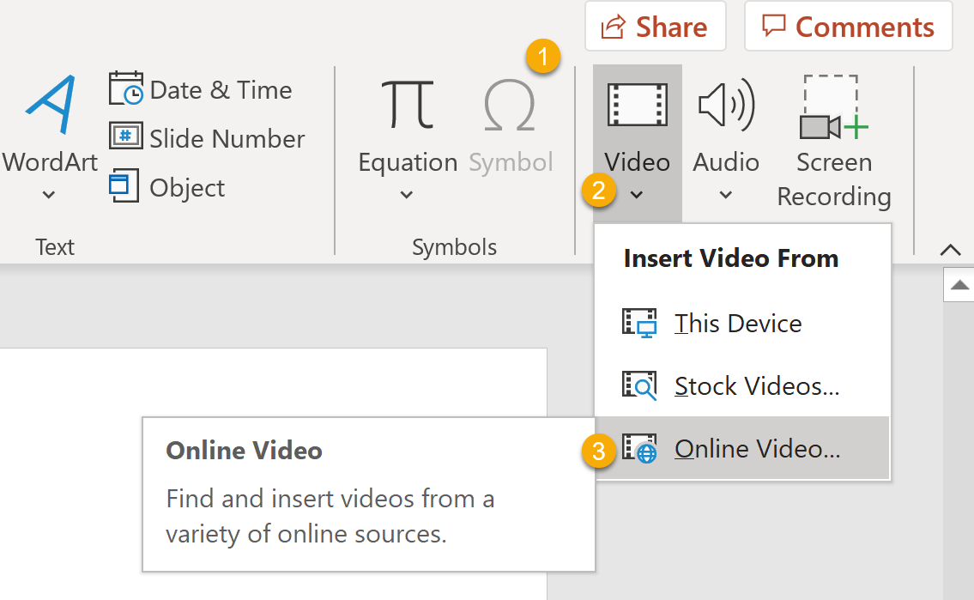
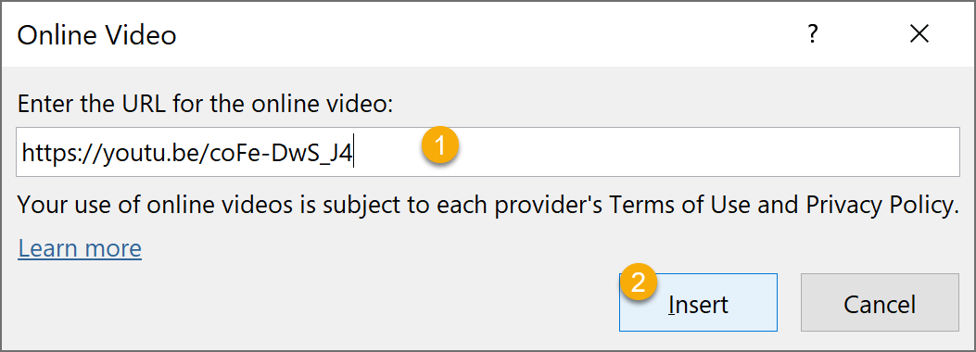
Add an Online Video
Select Insert.
To add a Video:
Select Video.
Insert Video From.
Select Online Video.

Slide 14


Slide 15
Add Transitions to bring your presentation to life
In the Thumbnail Pane, select the slide where you want to apply or change a transition.
On the Transitions tab, find the effect that you want in the Transition gallery.
Select Effect Options to specify how the transition occurs.
If you want all slides in the presentation to transition the same way, select Apply To All.
Select Slide Show button The Begin Slide Show button. to view the transition.
Notes:
Animations and transitions can make your presentations more energetic and fluid. But don't overwhelm your audience: using 1-2 different styles per presentation is a good best practice.

Slide 16
Add Animations
Select the text or object that you want to animate.
On the Animations tab, select an animation effect from the gallery. Entrance effects icons are colored green, emphasis effects icons are colored yellow, and exit effects icons are colored red.
Some animations have Effect Options that add direction to animation.
Select Slide Show button The Begin Slide Show button. to view the animation.
Notes:
Animations and transitions can make your presentations more energetic and fluid. But don't overwhelm your audience: using 1-2 different styles per presentation is a good best practice.

Slide 17
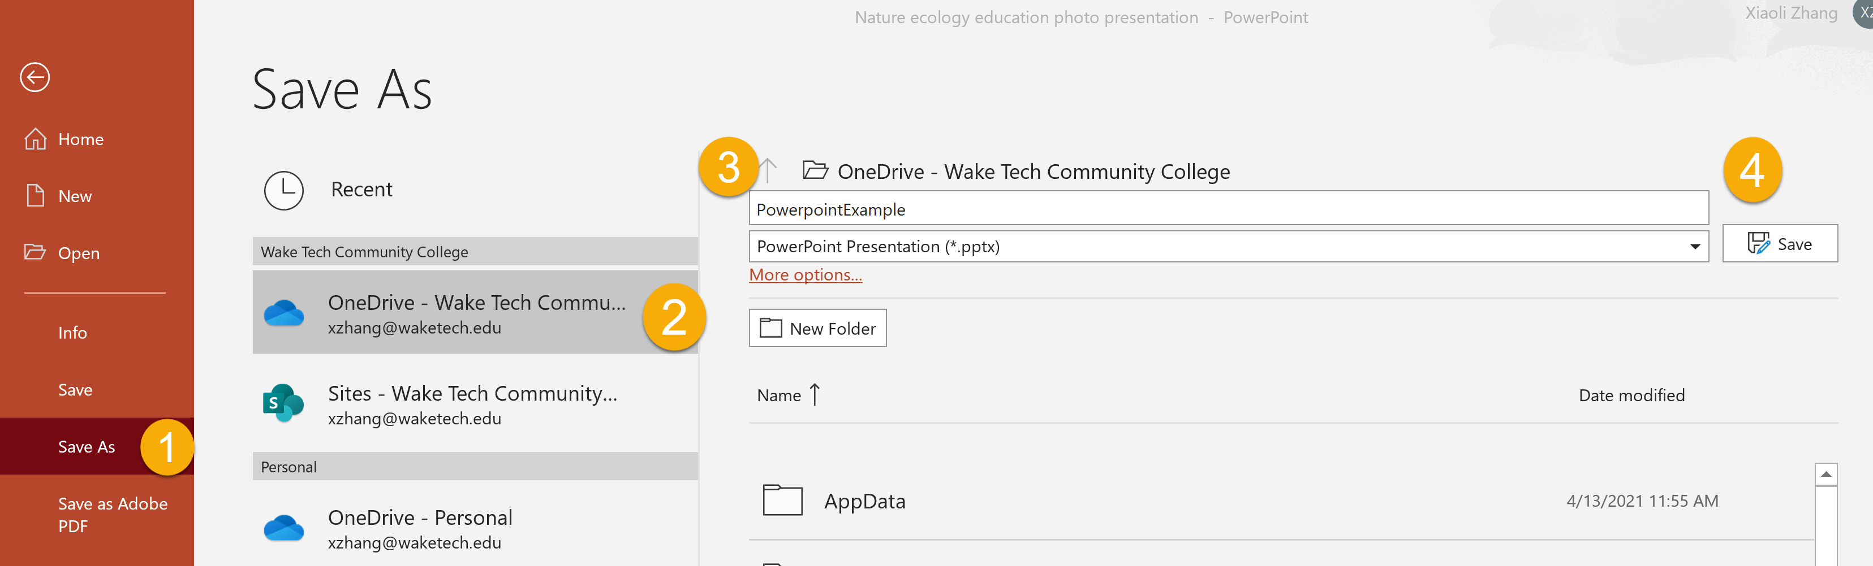
Save your presentation to OneDrive
When you save your files to the cloud, you can share and collaborate with others, and get to file from anywhere – on your computer, tablet, or phone.
Select File > Save As.
Select OneDrive.
Notes:
Save personal files to OneDrive –Personal, and work files to your company OneDrive. You can also save to another location, like your device.

Slide 18
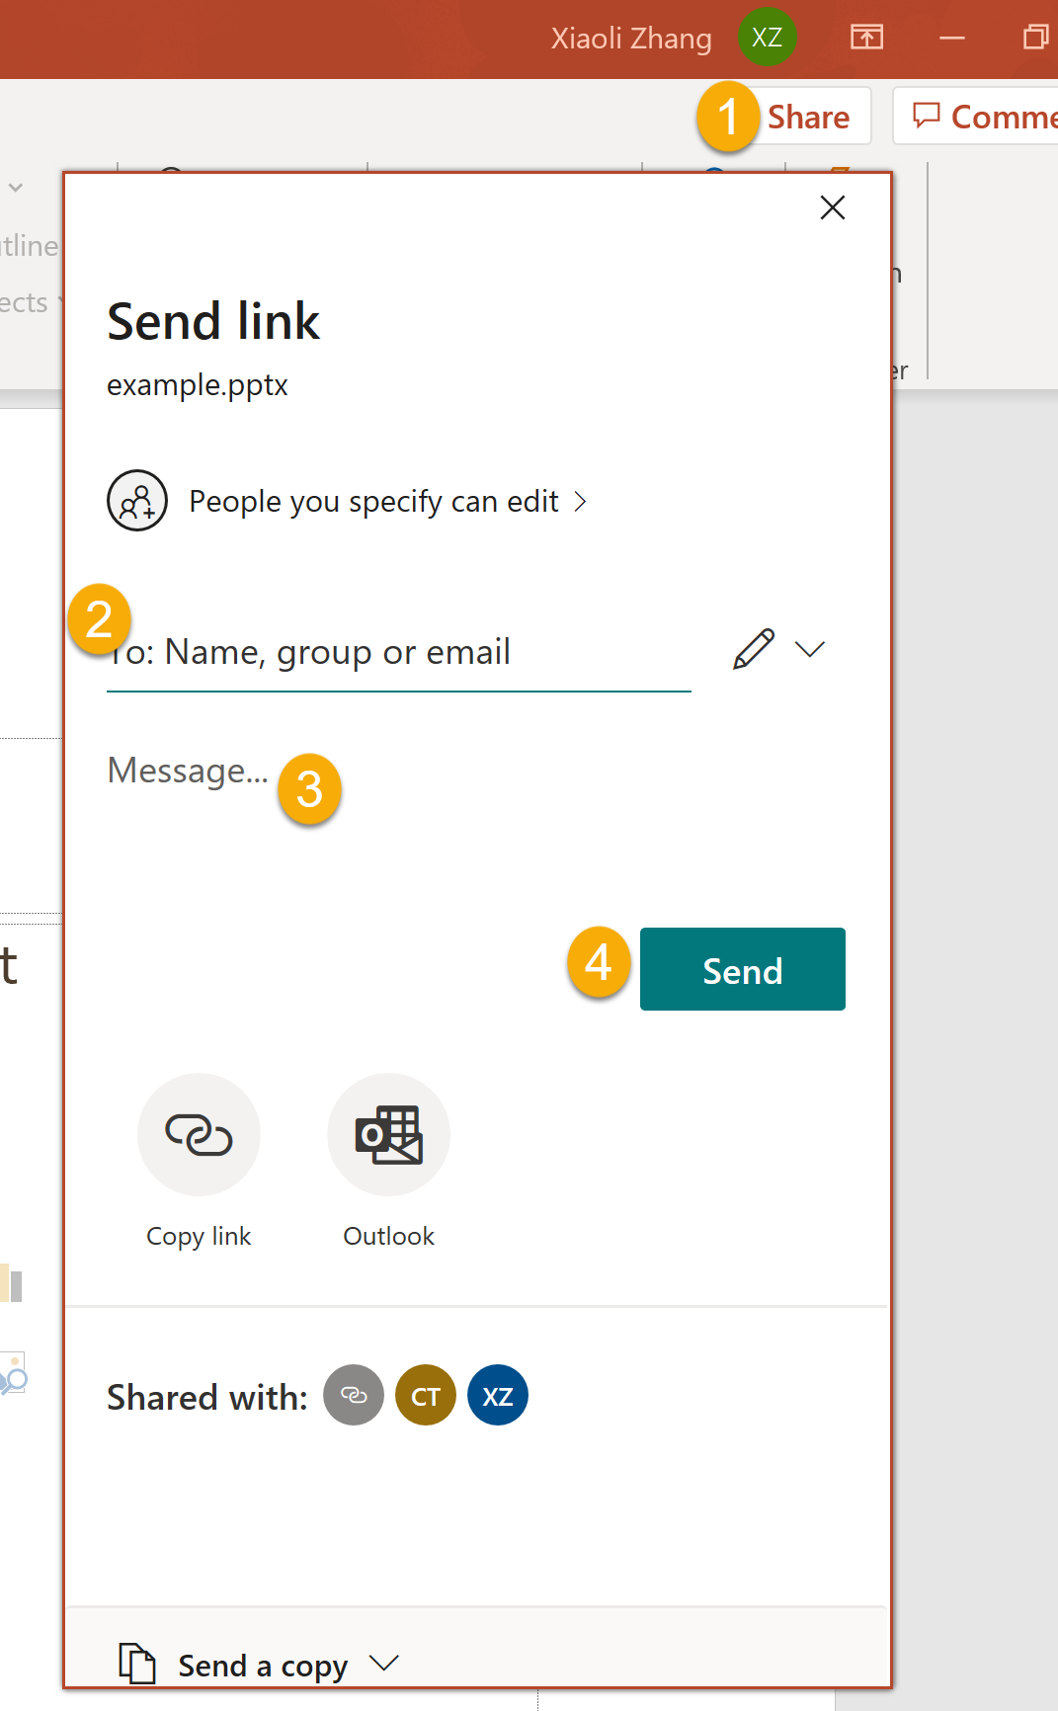
Share and collaborate in PowerPoint
Share your presentation
On the ribbon, select Share.
In the Send Link dialog box, do the following:
Enter the names or email addresses of the people you want to share with.
Select the drop-down to change permissions, if you want. Allow editing is checked by default. To change permission to view only, uncheck this box and select Apply.
Include a message if you'd like and select Send.
You can also select Get a link to create a link that you can copy into an email.
Notes:
. Share your presentation
On the ribbon, select Share. If your presentation isn't already saved to OneDrive, you'll be prompted to save it there.
In the Send Link dialog box, do the following:
Enter the names or email addresses of the people you want to share with.
Select the drop-down to change permissions, if you want. Allow editing is checked by default. To change permission to view only, uncheck this box and select Apply.
Include a message if you'd like and select Send.
You can also select Get a link to create a link that you can copy into an email.

